Slide 1

Analyzing
Sales Report

Slide 2

Aim
Aim
The aim of sales data is to provide insights and analysis on the performance of a company's sales efforts. This data can help businesses understand their customer behavior, identify trends, and make informed decisions to improve their sales strategies. Additionally, sales data can be used to forecast future sales, track the effectiveness of marketing campaigns, and evaluate the performance of sales teams. Ultimately, the aim of sales data is to drive revenue growth and improve overall business performance.
The aim of sales data is to provide insights and analysis on the performance of a company's sales efforts. This data can help businesses understand their customer behavior, identify trends, and make informed decisions to improve their sales strategies. Additionally, sales data can be used to forecast future sales, track the effectiveness of marketing campaigns, and evaluate the performance of sales teams. Ultimately, the aim of sales data is to drive revenue growth and improve overall business performance.

Slide 3

Introduction
Sales management has gained importance to meet increasing competition and the need for improved methods of distribution to reduce cost and to increase profits. Sales management today is the most important function in a commercial and business enterprise.

Slide 4
Methodology
The dataset contain information for the 100 Order ID.
Amazon data is from 2010 to 2016.

Slide 5
Data Exploration
Data exploration is the first step of data analysis and it is used to explore and visualized data to take any necessary actions. Based on our understanding of the data we can go with the appropriate data cleaning.

Slide 6
Data Importing
To Import the data into Power BI, Let’s start with the Get Data option under the home tab. As this is a CSV file, select the Text/CSV option from the drop-down list and the select the file named. After selecting the file, data will be displayed Click on Load and save data.

Slide 7
Data Cleaning
We need to clean the data with the help of Power Query Editor.
To open the Power Query Editor by clicking on Transform
Data under the Home tab and go to Power Query Editor.
In Power Query Editor, go to the View tab, enable Column Distribution, Column Quality and Column Profile. It will help you to find out missing values, any data errors, any data type mismatch, any outliers.

Slide 8
Data Visualization
I have used Power BI tool to visualize the data available to gain meaningful insights and better understand the dataset. I have used different visualizations like bar graphs, line graphs which are available in the tool.

Slide 9
Analysis
The dataset contains the following columns :
Region : An area of land.
Country :Distinct part of Region
Item Type :Enable us to record data according to its specific use.
Sales Channel : Method and pathway a business use to reach its customers and sell its products(Online/Offline)
Order ID : Unique number that gets assigned to an order placed by the customer.
Ship Date : The data that the order is shipped from the seller or warehouse to the customer.
Total Revenue : It is the total income of business and it is calculated by multiplying the quantity of item sold by the price of the item.

Slide 10
Average_delivery : I created this column to analyze Average_ship_Day.
Created new 3 Columns with Month, Year and month_year.
In our Analysis there are total 7 region, 76 Country with average ship day 23 and profit of 44 M.
I used slicer(dropdown) for Month OR Years.
Also used slicer(Tile) for region.
Used Ascending Clustered bar chart for Profit by item types and Unit Sold by item types where Cosmetics products have high demand.
Also created Donut chart for Total profit and Unit Sold by Sales channel.

Slide 11
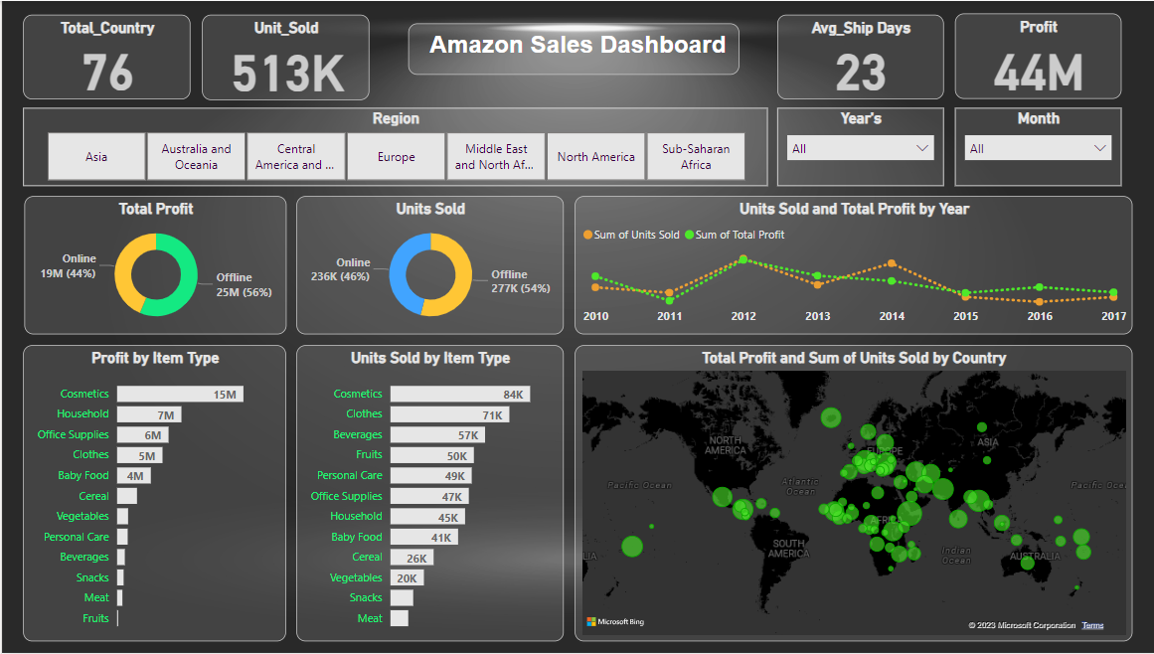

Slide 12
THANK YOU

